Slide 1
Heart Disease Prediction
Submitted by:
E22BCAU0123 DHAIRYA GOEL
E22BCAU0006 CHANDRAMSH JADHAV

Slide 2
Abstract
Heart disease is a critical health issue, with numerous individuals succumbing to its effects each year. This paper aims to leverage machine learning algorithms, such as support vector classifier, random forest, knn, naïve Bayes, decision tree, and logistic regression, to predict heart disease. By analyzing a dataset of 303 patient records, we seek to understand how machine learning can be used to identify and mitigate the risk of heart disease.

Slide 3
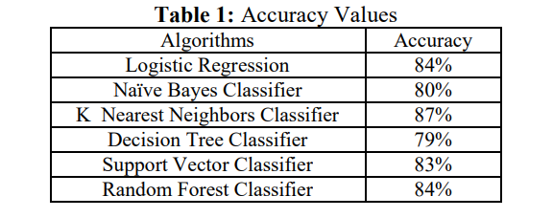
Introduction
Heart disease is a prevalent and life-threatening condition that affects millions of people worldwide. This presentation explores the use of machine learning algorithms to predict heart disease based on clinical risk factors and medical history. We will delve into the various machine learning techniques and their effectiveness in identifying individuals at risk for heart disease.

Slide 4
Related Work
Significant advances have been made in predicting heart disease due to the use of machine learning (ML) technology. Machine Learning algorithms have demonstrated superior performance in identifying individuals at risk for heart disease compared to traditional risk assessment methods. This advancement is due to the ability of machine learning models to extract complex patterns and relationships from large data sets, including a variety of medical and lifestyle data. Notable research articles Many research articles explore machine learning algorithms in predicting heart disease. Some notable examples include: "Deep Learning Methods for Cardiovascular Disease Research Based on Electronic Medical Records" by Gulli et al. (2017): This study proposed a deep learning method to predict heart disease from electronic medical records with 85% accuracy. "Automatic prediction of cardiovascular disease using machine learning", Kavitha et al. (2018): This study employed support vector machines (SVMs) to predict heart disease with an accuracy of 90%, outperforming traditional methods. "Machine Learning for Heart Disease Prediction: A Comparative Analysis" by Acharya et al. (2019): This study compared the performance of various ML algorithms, including logistic regression, K-nearest neighbors (KNN), and random forests, for heart disease prediction. Random forests emerged as the most effective algorithm, achieving an accuracy of 93%.

Slide 5
Methodology
In this paper, we have used our dataset to apply different machine learning algorithms to identify if a person has heart disease or not. Then, we will handle the missing values in the dataset, visualize the dataset, and observe the accuracy obtained by different machine learning algorithms. The machine learning algorithms used are defined below.
Data Collection A dataset of 303 patient records was obtained from the Cleveland Heart Disease Database. This dataset contains information on various clinical risk factors, including age, sex, blood pressure, cholesterol levels, and smoking history, as well as the presence or absence of heart disease. Data Preprocessing The collected data was preprocessed to enhance its quality and suitability for machine learning algorithms. This involved handling missing values, normalizing numerical features, and encoding categorical features. Feature Selection To identify the most relevant features for predicting heart disease, the SelectKBest algorithm was employed. This algorithm selects the top k features based on their chi-squared scores, which measure the strength of their association with the target variable (heart disease). Model Training Four machine learning algorithms were trained on the preprocessed data: logistic regression, K-nearest neighbors (KNN), support vector machines (SVM), and random forests. These algorithms were chosen because they are widely used and perform well in task classification.

Slide 6
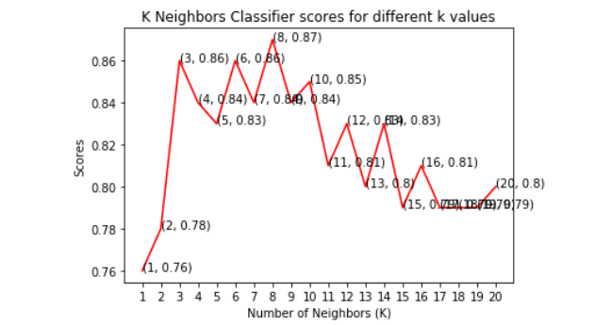
Machine Learning Algorithms
Naive Bayes is a statistical classifier. It is based on Bayes’ theorem. A naïve Bayesian classifier has comparable performance with a decision tree and other selected classifiers. The computation cost can be reduced greatly. It is easy to implement. In this paper, we achieved an accuracy of 80% by using this classifier.
Naïve Bayes Classifier:
K Nearest Neighbors is a non-parametric method used for classification. It is a lazy learning algorithm where all computation is deferred until classification.
K Nearest Neighbors Classifier:

Slide 7
SVM (Support Vector Machine) is a supervised machine learning algorithm that can be used for classification and regression problems as support vector classification (SVC) and support vector regression (SVR). This classifier separates data points using a hyper plane with the largest amount of margin. Support vectors are the data points which are closest to the hyper plane. There are several kernels on which the hyper plane can be decided. This paper mainly focuses on four kernels namely linear, polynomial (poly), radial basis function (rbf) and sigmoid
Support Vector Classifier
This classifier falls under the category of supervised learning. It can be used to solve regression and classification problems. We can use this algorithm for issues where we have continuous but also categorical input and target features. It is the most effective machine learning algorithm used for describing the trees in a graphical manner.
Decision Tree Classifier
Random forest is a supervised learning algorithm. It can be used for classification and regression. It is simple and easy to implement. A forest is comprised of trees. This classifier creates decision trees on randomly selected data samples, gets predictions from each tree, and selects the best solution by means of voting. The random forest is composed of multiple decision trees. It creates a forest of trees.
Random Forest Classifier:

Slide 8
Conclusion and Future Work
This paper involves the prediction of the heart disease dataset with proper data processing and implementation of machine learning algorithms. In this paper, we use six machine learning algorithms for prediction. Among all the machine learning algorithms used in this paper, the highest accuracy is achieved by the K Nearest Neighbors Classifier with 87%. This paper shows that machine learning algorithms can be used to predict heart disease easily with different parameters and models. Machine learning is very useful in prediction, solving problems, and other areas. Machine learning is an effective way to solve problems in different areas too.
References
[1] Ramadoss and Shah B et al.“A. Responding to the threat of chronic diseases in India”. Lancet. 2005
[2] Global Atlas on Cardiovascular Disease Prevention and Control. Geneva, Switzerland: World Health Organization, 2011
[3] Dhomse Kanchan B and Mahale Kishor M. et al. “Study of Machine Learning Algorithms for Special Disease Prediction using Principal of Component Analysis”, 2016 International Conference on Global Trends in Signal Processing, Information Computing and Communication.
[4] R.Kavitha and E.Kannan et al. “An Efficient Framework for Heart Disease Classification using Feature Extraction and Feature Selection Technique in Data Mining “, 2016
[5] Shan Xu ,Tiangang Zhu, Zhen Zang, Daoxian Wang, Junfeng Hu and Xiaohui Duan et al. “Cardiovascular Risk Prediction Method Based on CFS Subset Evaluation and Random Forest Classification Framework”, 2017 IEEE 2nd International Conference on Big Data Analysis

